Slide 1
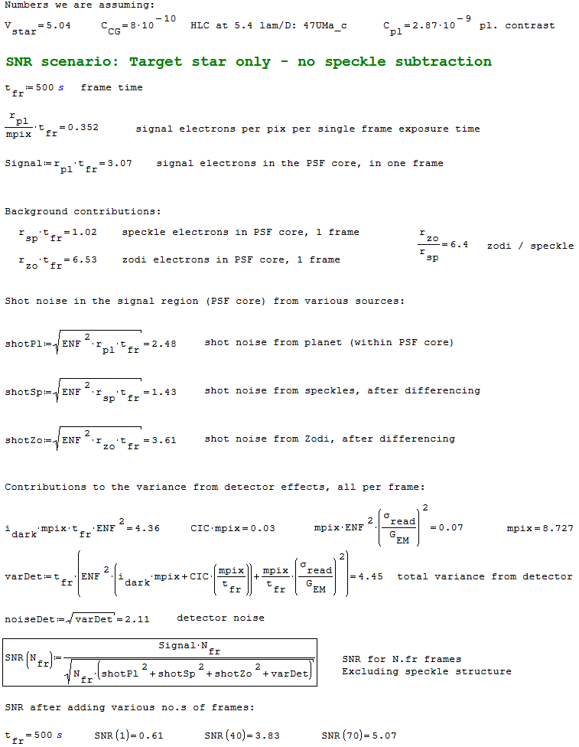
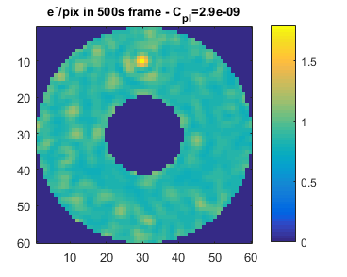
SNR check
47 UMa c
V = 5.04
HLC 20160126
15% band
C = 8e-10

Slide 2
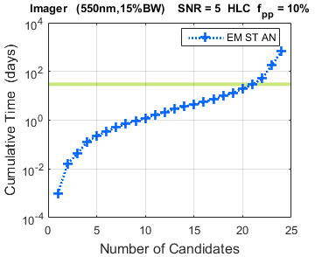
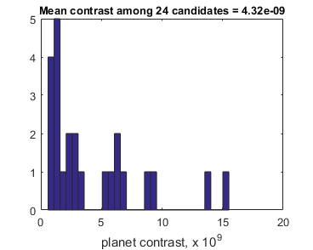
What is the typical planet contrast?
Take a coronagraph design,
this time:
hlc_runpolx3_0.4mas_jitter_results.txt
histogram the candidates
mean is 4.3e-9 in planet contrast

Slide 3
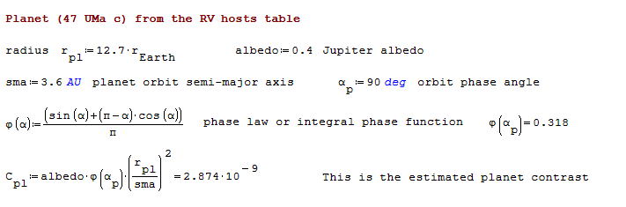
Example of Planet Contrast Calculation

